Slide 1
Lability
Lab management with PowerShell and Desired State Configuration

Slide 2





Rik Hepworth
Consulting Services Director
MVP (Azure)
@rikhepworth
github.com/rikhepworth
blogs.blackmarble.co.uk

Slide 3
How did we get here
TFS Lab Management is dead
SCVMM is too complex (and no desktop version!)
Vagrant states that Windows images must disable UAC
We wanted a single approach for user/lab/cloud
We like PowerShell ☺

Slide 4
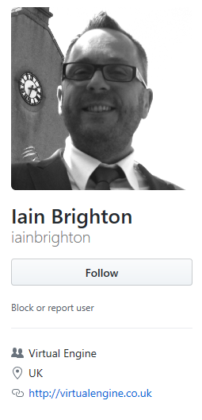
What is Lability?
PowerShell module
Uses DSC on the host to provision VMs
Uses DSC in the guest to configure VMs
Will also work with Linux (sort of)
Saint

Slide 5
How do we use it?
We have our own wrapper module
We have standard configurations for server role
We collect those roles into environments
Developers self-deploy environments locally
VSTS Release deploys shared labs
Azure DevTest Labs uses ARM templates and the same DSC

Slide 6

Demo
@rikhepworth
github.com/rikhepworth
blogs.blackmarble.co.uk

Slide 7
Useful Links
Lability on Github https://github.com/virtualengine/lability
DSC Resources: https://github.com/PowerShell/DscResources
@rikhepworth
github.com/rikhepworth
github.com/rfennell
blogs.blackmarble.co.uk

